Slide 1
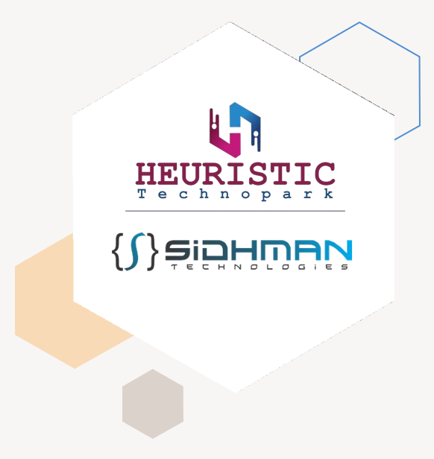
Meetup with Trending Career
Vinay Mahajan
Technical Director
Philips (R&D)
CDAC (R&D)
Trainer – ACTS(CDAC), M&M, John Deer, ITC Ltd, IIT Bombay
12 years of Experience in IT Industry

Slide 2
Seminar on :
Trending Topics, Problems, Solutions
&
Industrial Automation Evolution

Slide 3

Industry Survey
Student Survey
Solution We
provide
Market Survey
Agenda
Our Goal
Presentation Title
3

Slide 4

Introduction
A trend is a form of collective behavior in which a group of people enthusiastically follow an impulse for a short period.
The career is an individual's metaphorical "journey" through learning, work and other aspects of life.
4

Slide 5

1
Student Survey

Slide 6
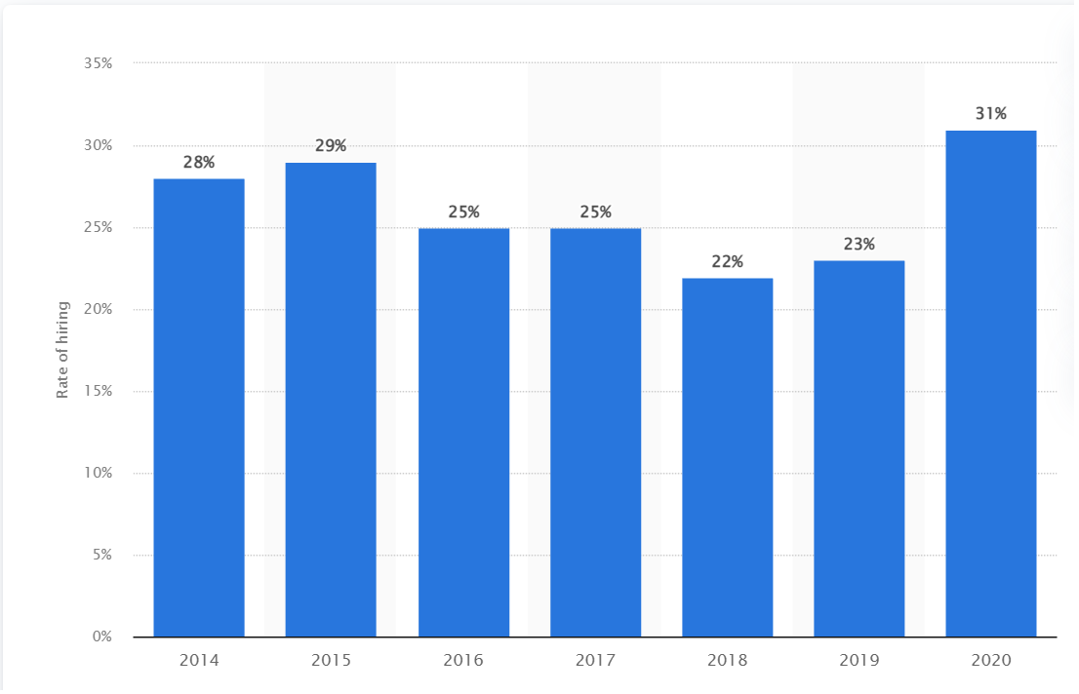
HIRING OF STUDENTS
India annually produces fifteen lakh engineering graduates.
The rate of hiring among engineering graduates across India stood at 31 percent in 2020.
6

Slide 7
Only 3% of India’s engineering graduates land quality tech jobs with packages over
Rs 8 lakh
Over 80% of these graduates end up pursuing non-technical careers due to lack of available
employment opportunities, claims survey
Source :- https://indianexpress.com
Only 3.84% of engineers are employable in software-related jobs at start-ups.
On an aggregate level, employability in these areas is around 1.5-1.7%
Source :- https://www.shl.com
7

Slide 8
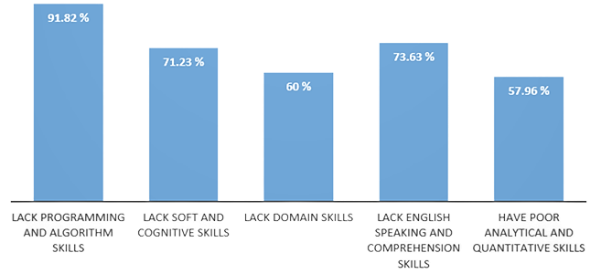
PROBLEMS FACED BY INDIAN STUDENTS
8

Slide 9


LACK OF AWARNESS IN STUDENTS
Awar about own career 15%
Nearly 85% of higher education candidates not equipped to take career decisions: Survey
Source :- https://economictimes.indiatimes.com
Lack of awarness about career
85%
8

Slide 10
“Educational opportunities are like buses. There’s always another one coming.”
Richard Branson
10

Slide 11
2
Industry Survey

Slide 12











HIRING FRESHERS
Inaccurate resumes
Skill Gaps Attitudinal Issues Geographic Divide
City Wise Hiring
12
Source :- https://www.thehindu.com

Slide 13
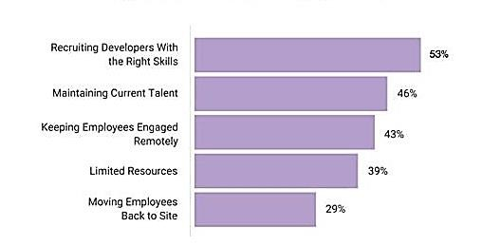
ISSUES COMPANIES FACE WHILE HIRING FRESHERS
13

Slide 14
3
Market Survey

Slide 15
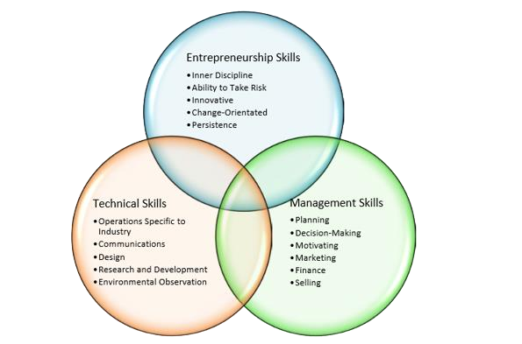

NEED OF MARKET
15

Slide 16
Vinay
Mahajan
Tejas
Paramsagar
Yogesh
Kumbhakarn
Snehal
Chaudhary
Core Team
Presentation Title
16

Slide 17

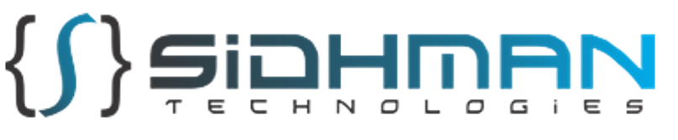

Slide 18

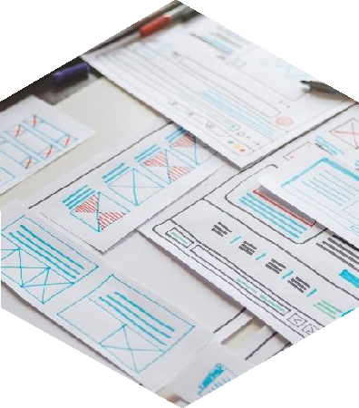


Our Services
Training & Placement We Provide profile based training and placement for deserving candidates. | Project Development We are active in design and development sector. We Provide design and development solution to industries.
IT Services IT Services like Machine vision, Machine Learning, web/App development etc. Solutions. | Corporate Training We provide corporate training to all the candidates optinig for our courses.

Slide 19


Slide 20
4
Solution We Provide

Slide 21
Areas of focus
TRAINING
Develop winning strategies to
keep ahead of the competition.
INTERNSHIP
Gain experience of how exactly
the industry works.
Develop the skills to stand in
market with a good value.
Get to know your capabilities.
Get to know the points on which you need to work on.
Find What, Goal, Purpose

Slide 22









Plan for you
Web Professionals
Data Science & Analytics
UI/UX
Python + Django
AWS

Slide 23


Why Web Professionals ?
Presentation title

Slide 24

Why?
HTML (Hypertext Markup Language):
HTML is the backbone of web development. It defines the structure and content of web pages.
It remains a fundamental skill for web developers as it forms the basis for creating web content.
CSS (Cascading Style Sheets):
CSS is essential for styling web pages and making them visually appealing.
With the rise of responsive web design and the need for mobile-friendly websites, CSS skills are more important than ever.
CSS preprocessors like SASS and LESS are also widely used in the industry.

Slide 25
Why?
JavaScript (JS):
JavaScript is a crucial programming language for web development, enabling dynamic and interactive web experiences.
In 2023, JavaScript continues to be in high demand due to its versatility and its use in both frontend and backend development.
Knowledge of modern JavaScript frameworks and libraries is beneficial, such as Node.js for server-side development.
React:
React is a popular JavaScript library for building user interfaces.
It's widely adopted for building single-page applications (SPAs) and dynamic web applications.
React skills are highly sought after in the job market, and it has a strong and active developer community.

Slide 26
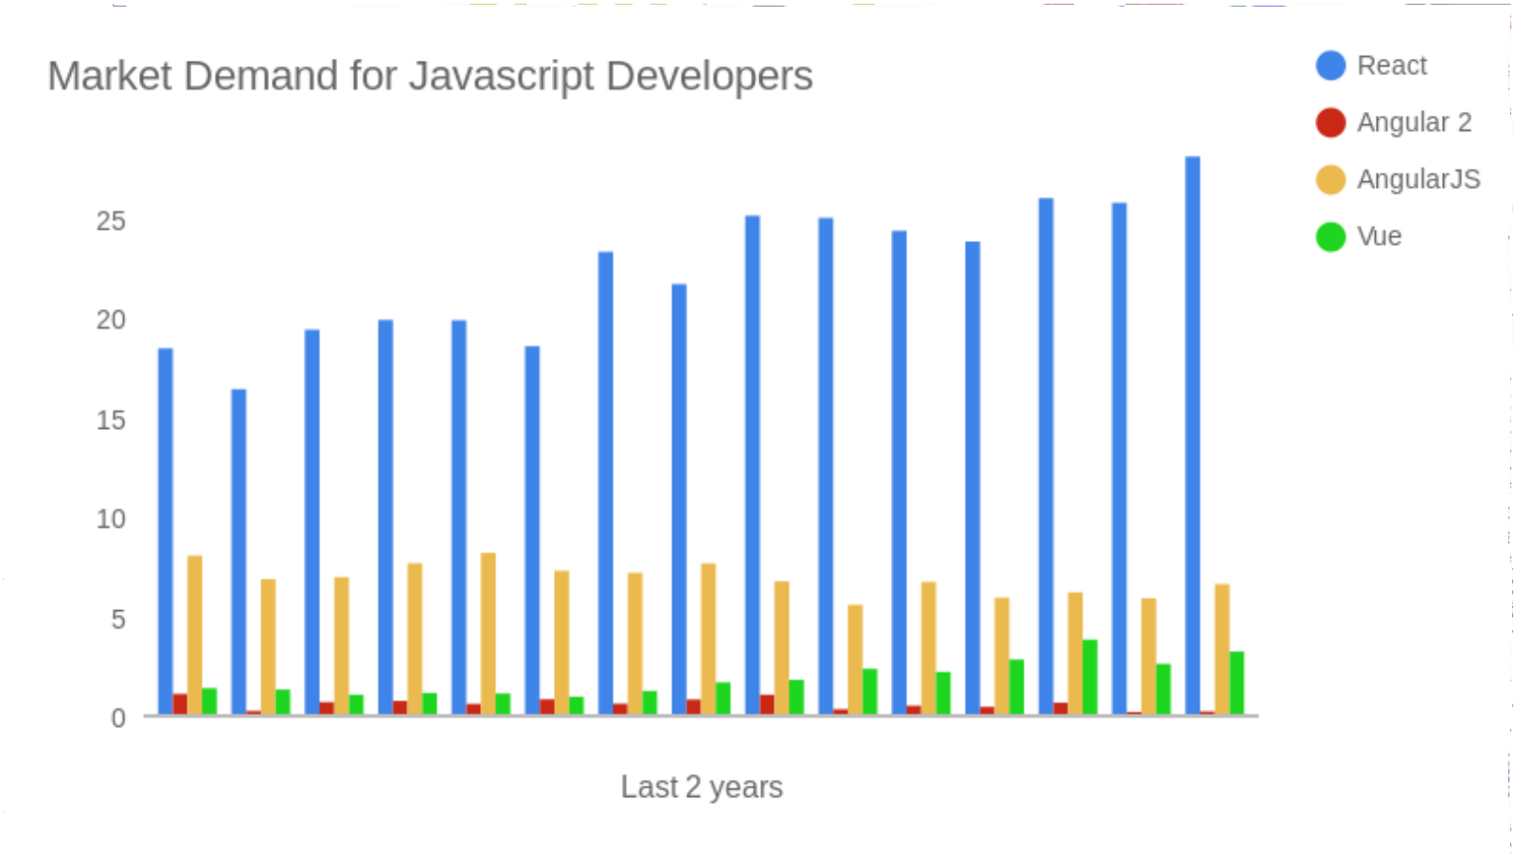

Slide 27
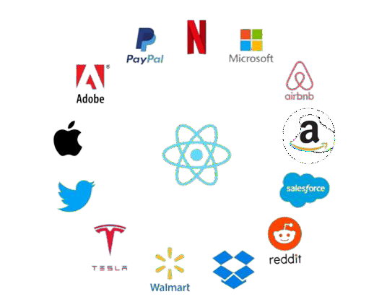

Slide 28
WHY Py + Dj ?

Slide 29

Python is a general purpose programming language that is often applied
in scripting roles.
So, Python is programming language as well as scripting language.
Python is also called as Interpreted language

Slide 30
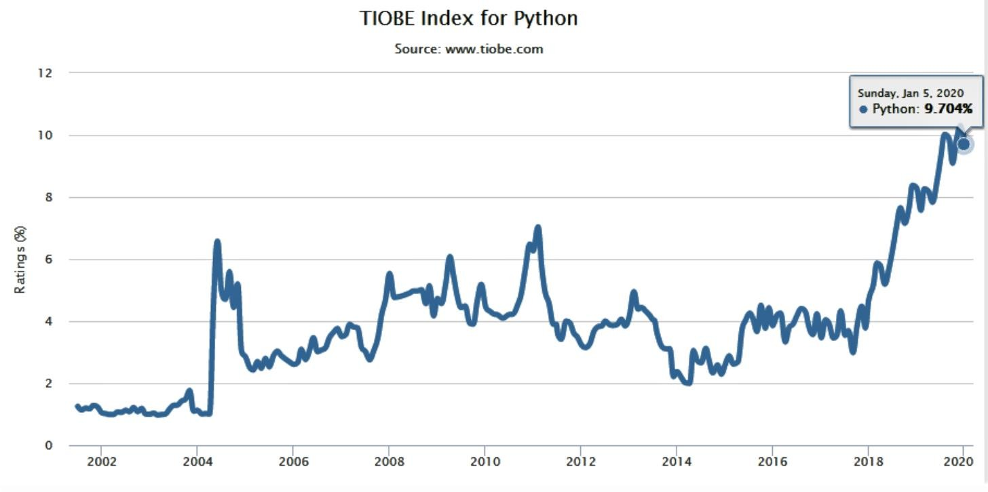
Python developers are in high demand - not only because the language is so popular and widely used but mostly due to the fact that Python became a solution in many different areas. From web applications to data science and machine learning.

Slide 31
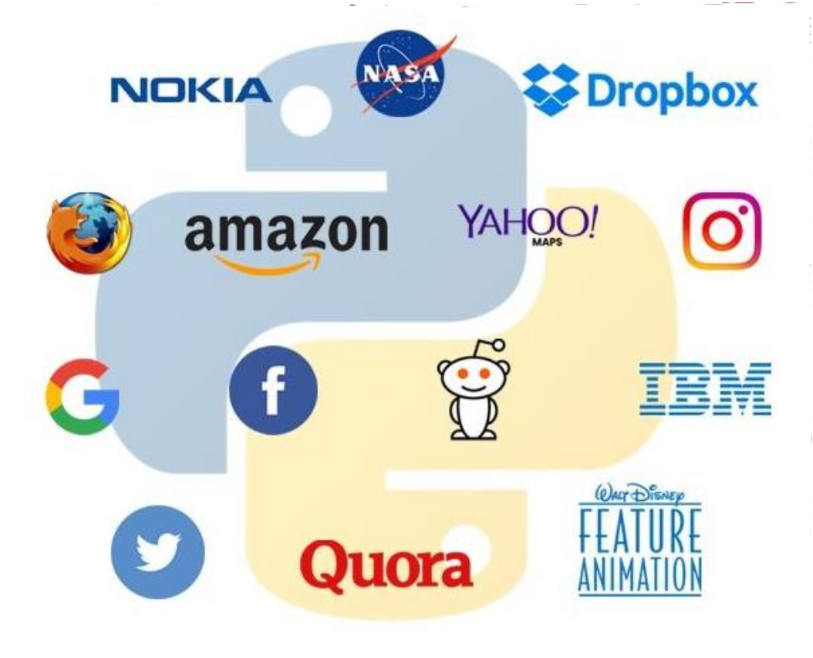

Slide 32

Django is a free and open source web application framework,
written in Python.
A web framework is a set of components that helps you to
develop websites faster and easier.
Presentation title
35

Slide 33
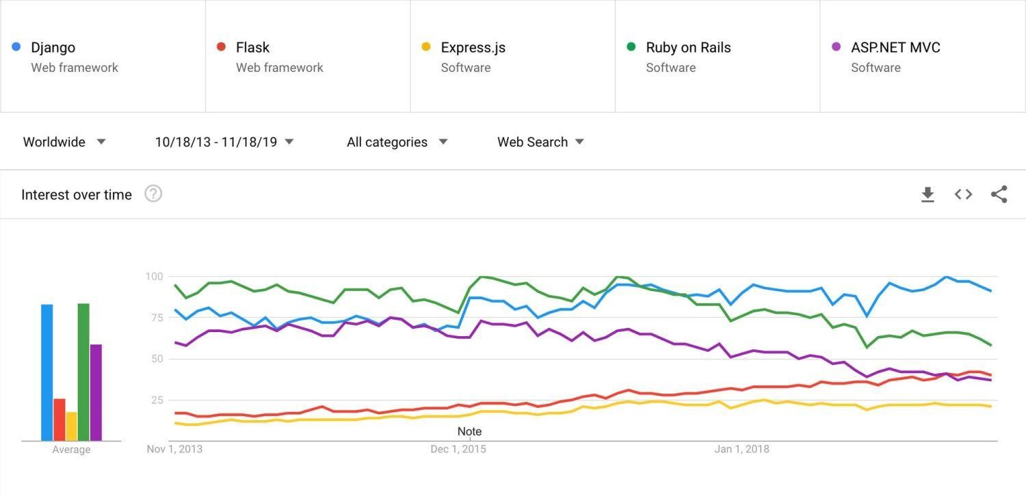

Slide 34


Slide 35
WHY UI/UX?

Slide 36
User Interface (UI) and User Experience (UX) are critically important aspects of modern web and application development for several reasons:
User-Centric Design: UI/UX design places the user at the center of the development process. It focuses on creating products and interfaces that are intuitive, efficient, and enjoyable for users. This approach ultimately leads to better user satisfaction.
Competitive Advantage: In a crowded marketplace, having a well-designed UI/UX can set your product or service apart from the competition. A visually appealing and user-friendly interface can attract and retain users.
Reduced User Friction: A well-designed UI/UX minimizes user friction, making it easier for users to accomplish their tasks or goals. This, in turn, can lead to higher conversion rates, whether you're selling products, collecting data, or providing information.
Lower Support Costs: Good UX design reduces the need for user support and troubleshooting. When users can easily navigate and understand your product or website, they are less likely to encounter problems and require assistance.

Slide 37
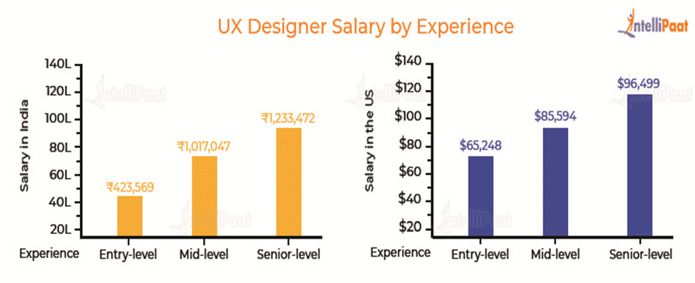

Slide 38
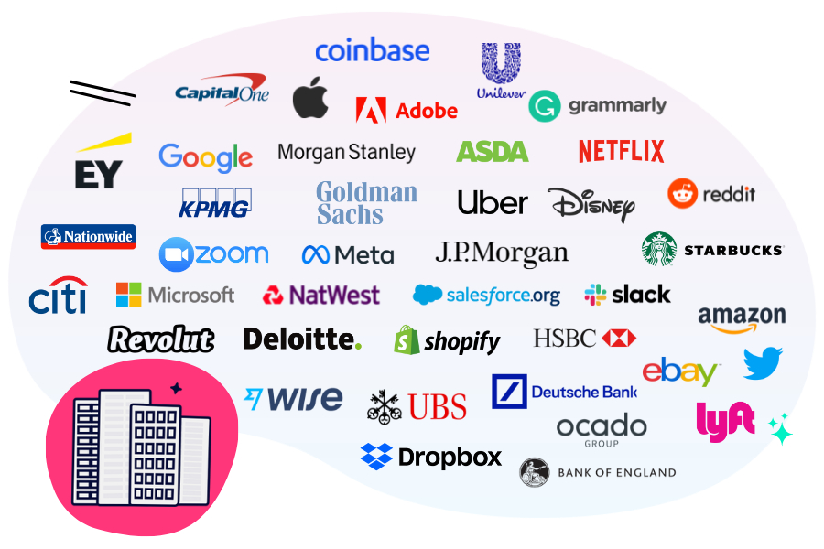

Slide 39
WHY Data science and Analytics?

Slide 40
Data Science and Data Analytics are closely related fields that involve the analysis of data to extract meaningful insights and drive decision-making.
Informed Decision-Making: Data science and analytics help individuals and organizations make more informed decisions. By analyzing data, you can identify trends, patterns, and insights that inform your choices, leading to better outcomes.
Competitive Advantage: Businesses that effectively use data science and analytics gain a competitive edge. They can uncover market trends, customer preferences, and opportunities that may not be apparent through traditional methods, allowing for agile and strategic decision-making.
Cost Savings: Data analytics can uncover areas of inefficiency, waste, or overspending within an organization. Identifying these areas allows for cost reduction and resource optimization.
Improved Product and Service Development: Data-driven insights enable companies to develop products and services that align more closely with customer needs and preferences. This leads to more successful offerings and greater customer satisfaction.

Slide 41
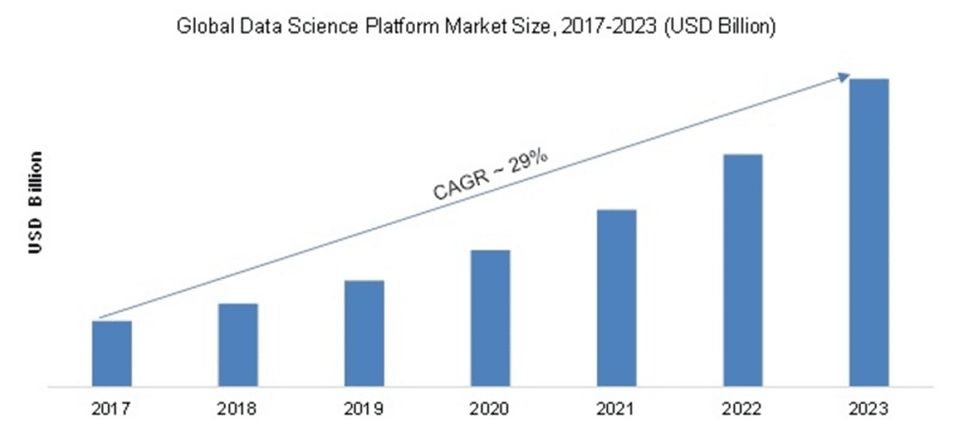

Slide 42
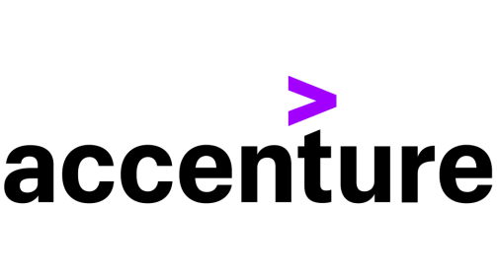







esummarizer

Slide 43
WHY AWS?

Slide 44
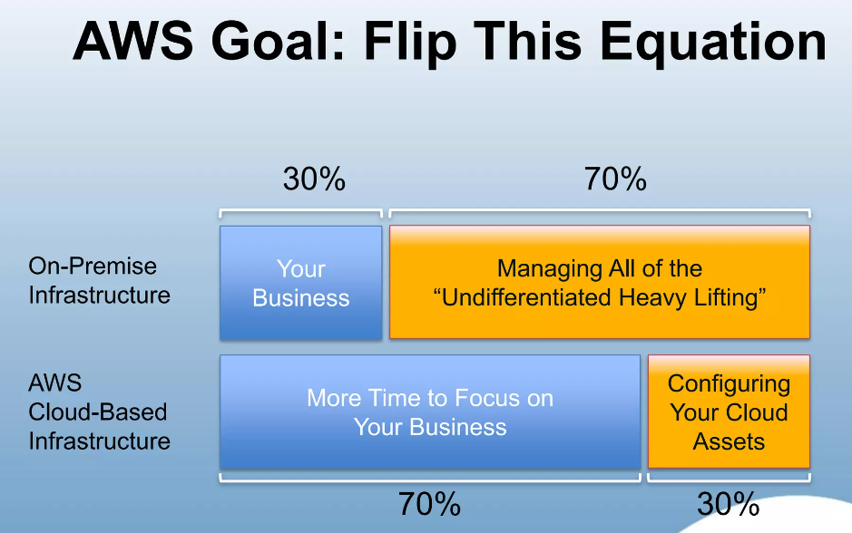

Slide 45
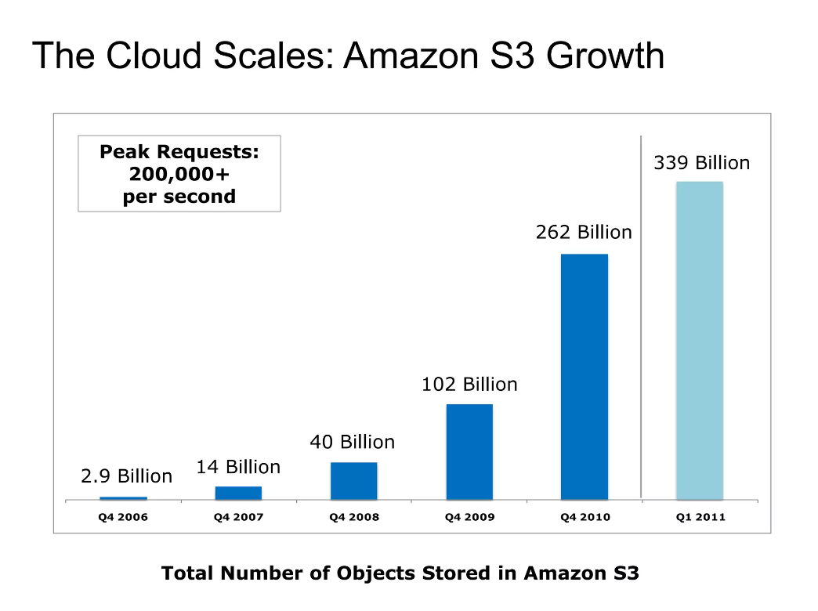

Slide 46
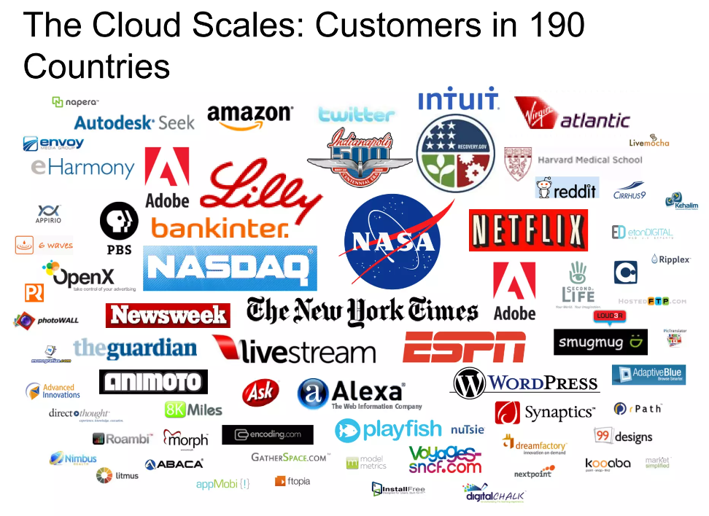

Slide 47


Summary
We Believe in giving students such knowledge that industry wants them to know while appearing for an interview at their own home town.
For a creative and automated world we shape you to be
such creative one

Slide 48









Thank you
Contact us :
9922367322 / 9309079965 heuistictechnopark@gmail.com
www.sidhman.com www.heuristictechnopark.com

